Slide 1
Pythonic OOP
Object oriented python

Slide 2
What OOP is in short
A way of structuring programs so that properties and behaviors are bundled into individual objects
An object could represent a person, with properties as name, age, address …
And behaviors like walking, talking, breathing …
OOP models real world entities as software objects which have some associated data and can perform certain functions
Encapsulate code into hierarchical groupings using classes

Slide 3
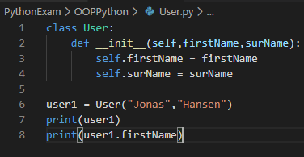
Creating classes and instances
A very simple example of defining class User
__init__ method gets called when an object is created
Self keyword refers to the specific instance of the class
Always needs to be there in instance methods
Can then create instances of User as so
userX = User()
Printing it will also show, that it is an object
And the individual properties can be accessed

Slide 4
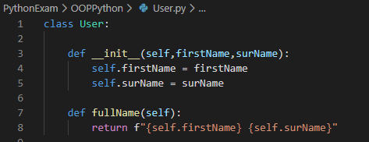

Instance methods
A function becomes a method when added to an object/part of a class
Example of instance method
Will be able to create an instance and then use the method

Slide 5
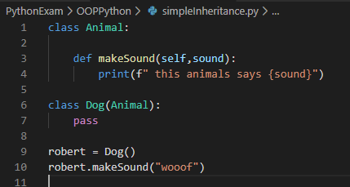
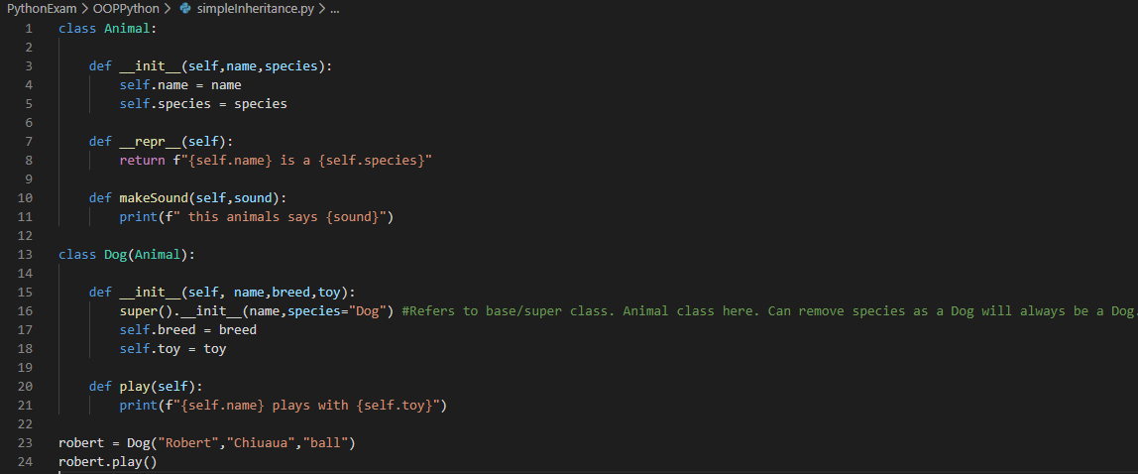
Inheritance
A key feature of OOP
Ability to define a class which inherits from another class, a so called “Parent class”
In Python it works by passing the parent class as an argument to the definition of the child class
Simple example →
Idea is to avoid duplicate
Child has what parent has, and additionals
Example of inheritance and then adding additional

Slide 6

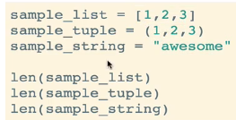
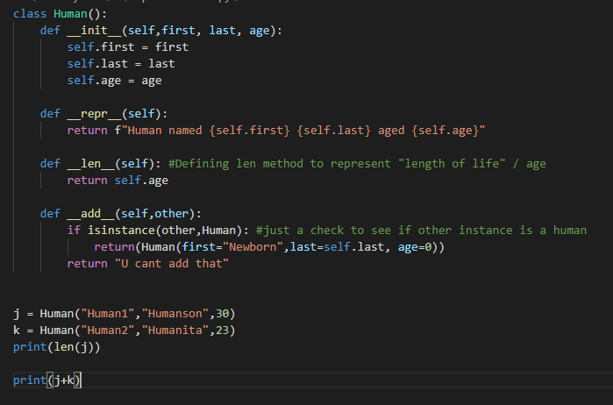
Polymorphism
Basically means that an object can take on many “forms”
1. A single method can work in a similar way for different classes
2. Same operation works for different kinds of objects
“Special methods”
Can define own add, len or other methods
Which then work on human objects
This will allow + operation on human objects

